Slide 1

Accelerating QAOA using ML
Variational quantum Algorithms
Qaoa
qaa
Maxcut problem

Slide 2
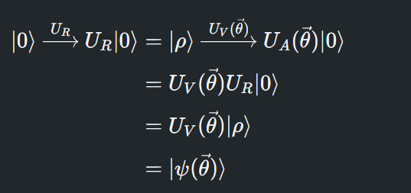
INITIALIZE THE PROBLEM : Transforming a default state to some desired non parameterized state (reference state), by applying some unitary transform on the default state. PREPARE ANSATZ : Any particular combination of reference state and variational form is known as ansatz. The variational form represents a collection of parameterized states for our variational algorithm to explore. The Ansatz will take the form of parameterized quantum circuits capable of taking the default state to the target state.
Variational algorithm design

Slide 3

EVALUATE COST FUNCTION : Encode the problem into a cost function as a linear combination of Pauli operators, run on a quantum system. OPTIMIZE PARAMETERS : Evaluations are taken to a classical computer, where a classical optimizer analyzes them and chooses the next set of values for variational parameters. ADJUST ANSATZ PARAMETERS WITH RESULTS AND RE-RUN : The entire process is repeated until the classical optimizer’s finalization criteria are met and an optimal set of parameter values are returned. The solution state of our problem will be :
Variational algorithm design

Slide 4
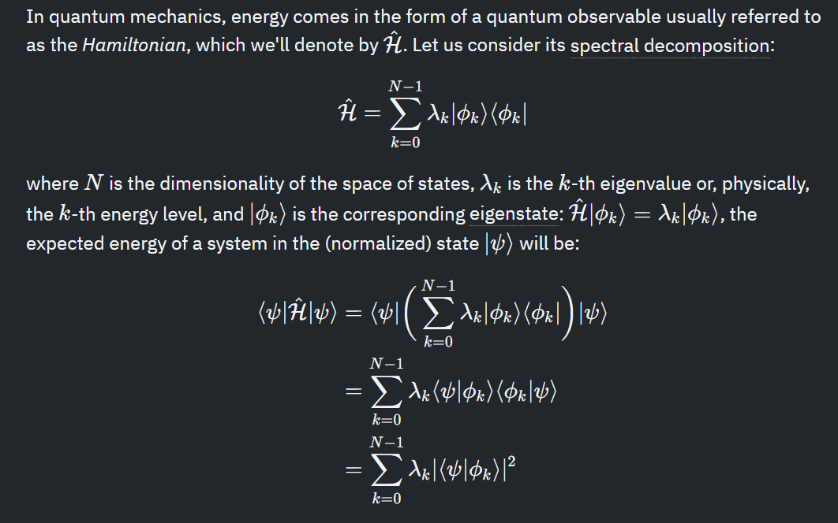
In quantum mechanics, states are represented by normalized complex column vectors, or kets (∣𝜓⟩∣ψ⟩), and observables are Hermitian linear operators (𝐻^ = 𝐻^†) that act on the kets. An eigenvector (∣λ⟩) of an observable is known as an eigenstate. Measuring an observable for one of its eigenstates (∣𝜆⟩∣λ⟩) will give us the corresponding eigenvalue (λ) as readout.
Variational theorem

Slide 5
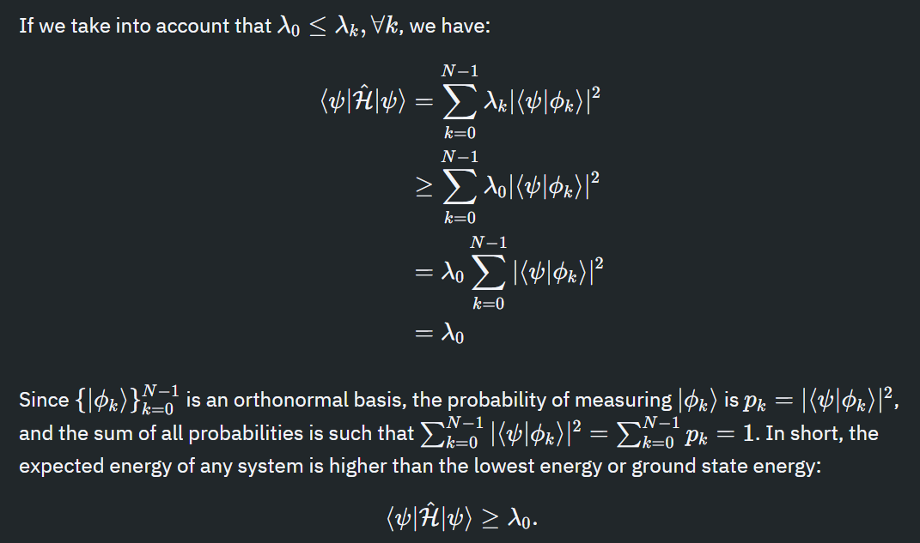
.
Variational theorem

Slide 6
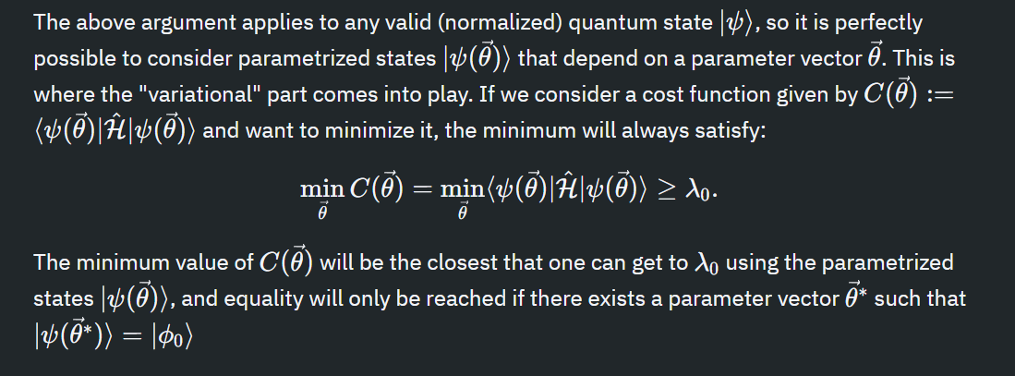
Variational theorem

Slide 7
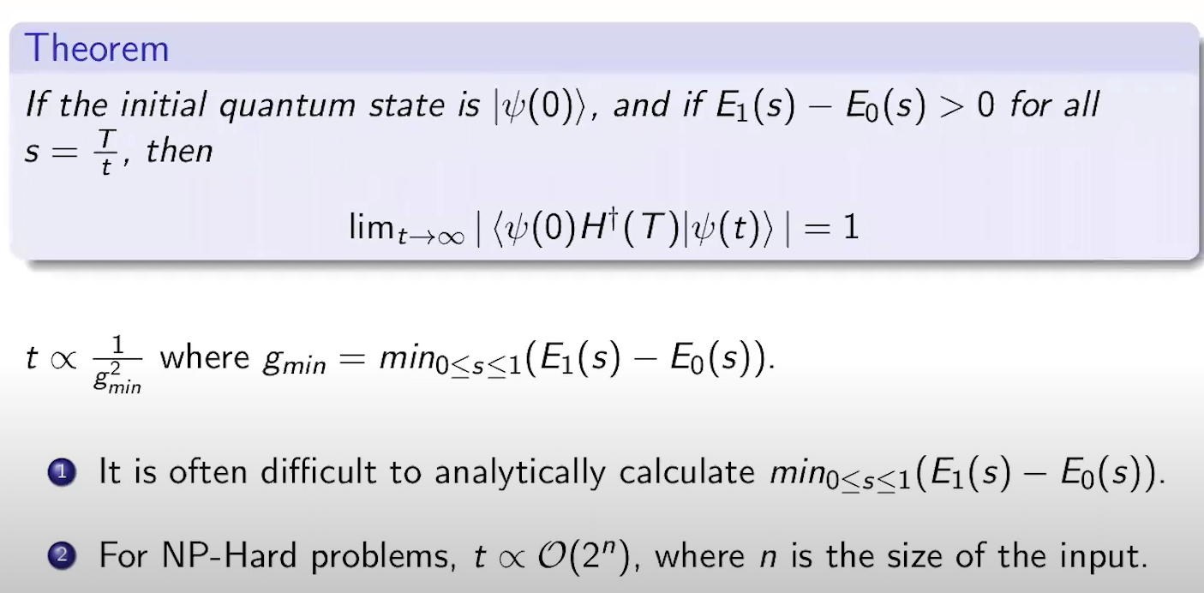
Suppose we have encoded a problem P in the description of a Hamiltonian H(p), such that its ground state is the solution of the problem. PROBLEM : It is difficult to prepare the ground state of H(p) . SOLUTION : Start with some Hamiltonian H(b) whose ground state is easy to prepare. A system prepared in the ground state of H(T) = (1-T/t)H(b) + (T/t)H(p) will settle in the ground state of H(p), if T varies slowly enough.
Quantum adiabatic algorithm

Slide 8
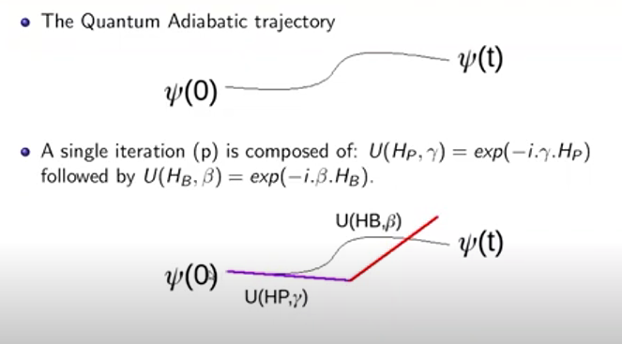
For p =1,
Quantum adiabatic algorithm

Slide 9
A QAOA is a variational algorithm, where first a trial parameterized circuit, called ansatz, is prepared which is initialized, usually with some random parameters. The circuit is then measured and the expectation value of some observable is then calculated. This entire process is called one iteration. This value is passed to a classical optimizer, which predicts a new set of parameters such that the following iteration is expected to provide a better expectation value. The process is repeated till some convergence criteria is met. A QAOA is characterized by two unitaries.
Quantum approximate optimization algorithm

Slide 10
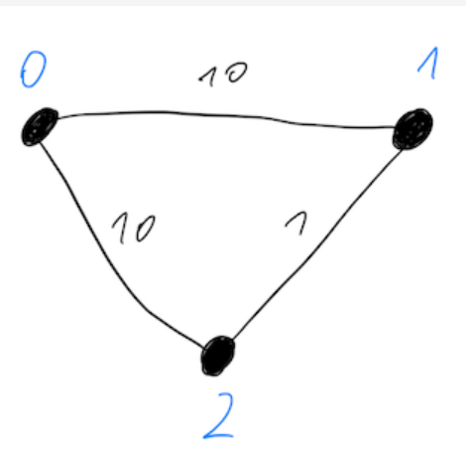
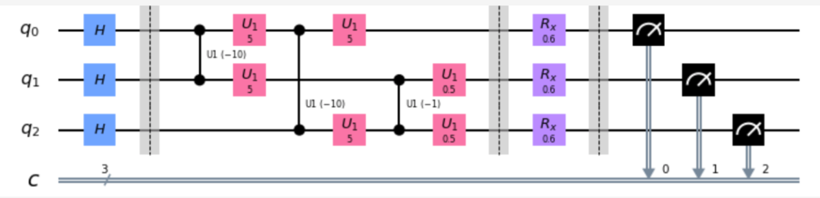

THE MAXCUT PROBLEM
Quantum approximate optimization algorithm AND MAXCUT PROBLEM

Slide 11
TO UTILIZE QAOA FOR A MAXCUT PROBLEM, WE REQUIRE A PAULI HAMILTONIAN THAT ENCODES THE COST IN A MANNER SUCH THAT THE MINIMUM EXPECTATION VALUE OF THE OPERATOR CORRESPONDS TO THE MAXIMUM NUMBER OF EDGES BETWEEN THE NODES IN TWO DIFFERENT GROUPS. If we have an educated guess or datapoint from an existing optimal solution, the variational algorithm will converge faster, if used as starting point. https://github.com/Poulami2515/QC/blob/main/LR.ipynb
Quantum approximate optimization algorithm and maxcut problem

Slide 12
https://github.com/Poulami2515/QC/blob/main/LR.ipynb The paper “Accelerating Quantum Approximate Optimization Algorithm using Machine Learning” works on finding the most optimal starting point for the QAOA to converge and solve a given MaxCut problem. This paper has used four ML models to find make an educated guess , i.e., GPR, Linear Regression, RSVM, Regression Trees. The dataset to train these models, were built synthetically. The above code is a preliminary approach of building the dataset, in order to train the ML Model. https://ieeexplore.ieee.org/abstract/document/9116348 arXiv:2002.01089v2
Quantum approximate optimization algorithm and maxcut problem

Slide 13
https://github.com/Poulami2515/QC/blob/main/LR.ipynb Primitives provided by Qiskit : SAMPLER : For a given state, this primitive obtains probability of each possible computational basis state. ESTIMATOR : For a given quantum observable, operating on a quantum state, this primitive computes the expected value of the observable. https://ieeexplore.ieee.org/abstract/document/9116348 arXiv:2002.01089v2
Quantum approximate optimization algorithm and maxcut problem

Slide 14
https://learning.quantum.ibm.com/course/variational-algorithm-design/ https://www.mustythoughts.com/quantum-approximate-optimization-algorithm-explained https://ieeexplore.ieee.org/abstract/document/9116348 arXiv:2002.01089v2
REFERENCES

